Slide 1

Credit Card Fraud Detection
Exploratory Data Analysis on
Presentation By E. Akhil

Slide 2

Agenda
Introduction
Algorithms
EDA
Process of EDA
Implementation
Conclusion
References

Slide 3
Introduction
Essential for securing financial transactions against unauthorized activities.
Exploration through Exploratory Data Analysis (EDA) provides crucial insights.
Analyzing patterns and anomalies is key to detecting potential fraudulent transactions.
EDA enhances proactive measures, ensuring robust credit card security.

Slide 4
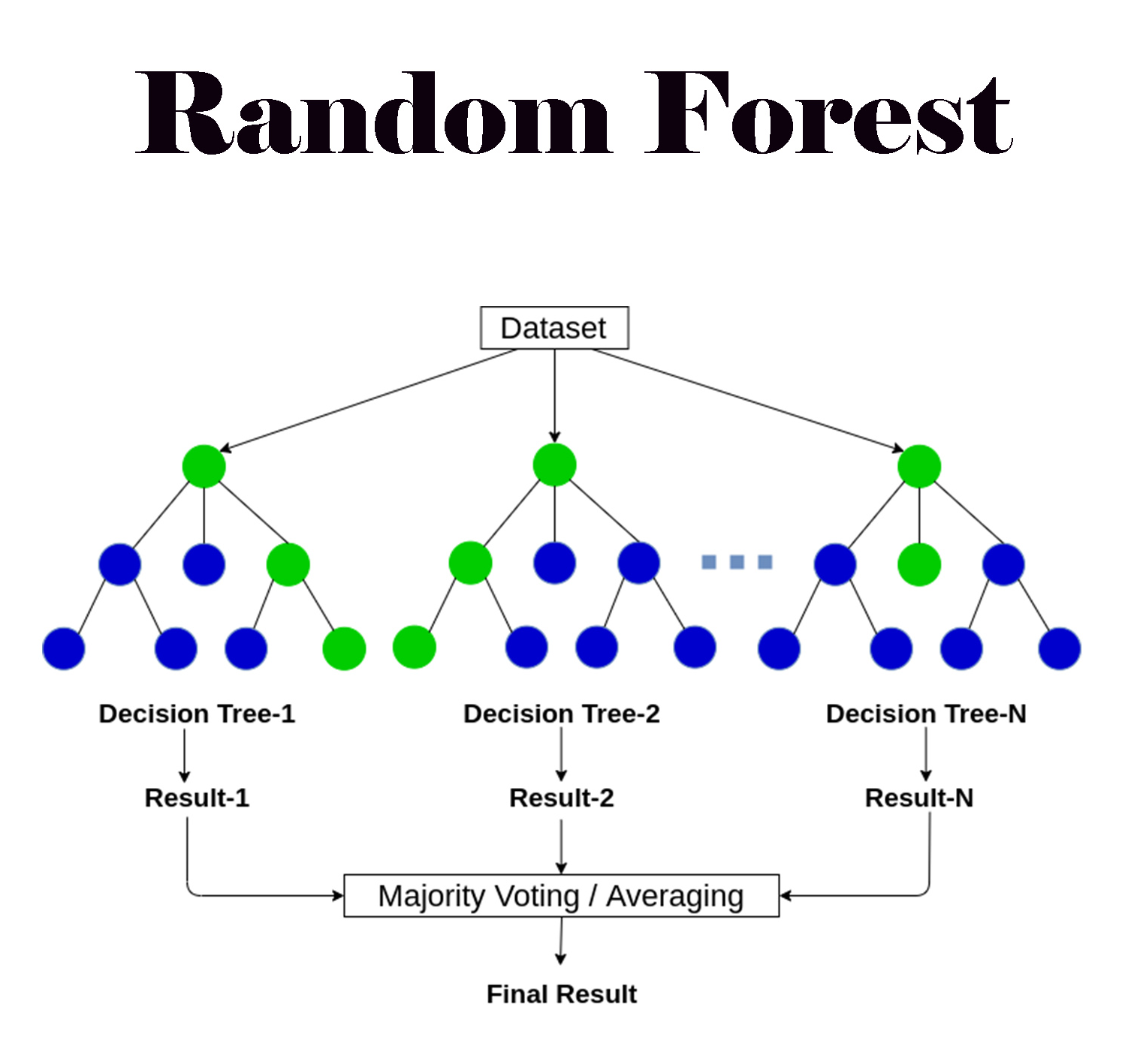
Algorithm
Random Forest:
Random Forest is like a teamwork algorithm. It's as if you ask many friends for advice before making a decision. Each friend (or tree) gives their opinion, and then, together, they help you make a smarter choice. It's a group effort for better results.

Slide 5
EDA
This is unavoidable and one of the major step to fine tune the given data set(s) in a different form of analysis to understand the insights of the key characteristics of various entities of the data set like column(s), row(s) by applying pandas, NumPy, statistical methods, and data visualization packages.

Slide 6
Process of EDA
Data Loading

Slide 7
Process of EDA
Data Loading
Analyze and visualize the data to gain insights
Model performance evaluation
Model optimization
Optimize the data
Clean the data

Slide 8
Process of EDA
Data Loading
Analyze and visualize the data to gain insights
Model performance evaluation
Model optimization
Optimize the data
Clean the data

Slide 9
Process of EDA
Data Loading
Analyze and visualize the data to gain insights
Model performance evaluation
Model optimization
Optimize the data
Clean the data

Slide 10
Process of EDA
Data Loading
Analyze and visualize the data to gain insights
Model performance evaluation
Model optimization
Optimize the data
Clean the data

Slide 11
Process of EDA
Data Loading
Analyze and visualize the data to gain insights
Model performance evaluation
Model optimization
Optimize the data
Clean the data

Slide 12
Process of EDA
Data Loading
Analyze and visualize the data to gain insights
Model performance evaluation
Model optimization
Optimize the data
Clean the data

Slide 13
Implementation
Install Anaconda
Launch Jupyter Notebook
Install all the required packages for the analysis
Now Start implementing the Machine learning Model

Slide 14
Conclusion
More complex classification algorithms, such as XGBoost, could be applied to this dataset.
Two optimization procedures are implemented: data optimization and model optimization. For each of them, there are more options to explore. For example, you could choose MinMaxScaler or MaxAbsScaler to preprocess data. And for model optimization, more advanced methods can be used, such as Bayesian Optimization and Evolutionary Optimization. There are also libraries like Ray-Tune, Optuna, Hyperopt, etc. for optimization use.
Outliers are not removed from the dataset. If you do, it could increase the metric performance.

Slide 15
References
https://www.kaggle.com/datasets/mlg-ulb/creditcardfraud/data
http://scikitlearn.org/stable/modules/generated/sklearn.ensemble.RandomForestClassifier.html
https://en.wikipedia.org/wiki/Receiver_operating_characteristic#Area_under_the_curve
http://scikit-learn.org/stable/modules/generated/sklearn.ensemble.AdaBoostClassifier.html
https://tech.yandex.com/catboost/doc/dg/concepts/python-reference_catboostclassifier-docpage/
http://xgboost.readthedocs.io/en/latest/python/python_api.html
https://www.microsoft.com/en-us/research/wp-content/uploads/2017/11/lightgbm.pdf

Slide 16
Q & A Section
LinkedIn: ejjada-akhil
GitHub: ejjada-akhil-13
Email: ejjadaakhil@gmail.com

Slide 17


